Slide 1

Introduction to Recurrent Neural Networks (RNNs)

Slide 2
What are RNNs?
Special type of neural network designed for sequential data
Key characteristic: They have "memory" through hidden states that persist between time steps
Unlike feedforward networks, RNNs have cyclic connections
Recurrent Neuron
A recurrent neuron refers to a neuron within a Recurrent Neural Network (RNN). Unlike traditional feedforward neural networks, where information moves in one direction from input to output, RNNs have connections that loop back on themselves, creating a cyclic flow of information. This feedback mechanism allows RNNs to maintain a form of memory, making them particularly effective for tasks involving sequential data.
Key Features of Recurrent Neurons:
Memory: A recurrent neuron has the ability to store previous inputs or states, which influences its output. This makes RNNs highly suitable for time-dependent tasks such as language modeling, speech recognition, and time-series prediction.
Feedback Loop: The recurrent connection allows the neuron to receive its own output from the previous step as part of the input for the current step. This enables it to process sequences of inputs and use context from previous inputs to influence its current output.
Hidden States: Recurrent neurons maintain a hidden state that stores the "memory" of previous computations. This hidden state is updated at each time step based on the current input and the previous state.
Training: Training RNNs can be more complex than feedforward networks due to the vanishing gradient problem. Backpropagation through time (BPTT) is used to train RNNs, where the error is propagated backwards through the network over time, adjusting weights accordingly

Slide 3
Why RNN?
RNN’s are specially designed for sequential data.
What is Sequential Data?
Data where order matters (past influences future)

Slide 4
Why RNN?
Examples:
Text: "The cat sat on the ___" → next word depends on previous words.
Time Series: Stock prices, weather data.
Speech: Audio waveforms over time.

Slide 5
Why Not Feed forward Networks?
Problem 1: No memory → treats inputs as independent.
Example: Feedforward network fails to predict "sky" in "The clouds are in the ___.“
Problem 2: Fixed input size → cannot handle variable-length sentences.

Slide 6
Real-World Applications
Google Translate: Many-to-many RNNs (seq2seq).
Text Generation: Predict next character (e.g., Shakespeare-style text).
Stock Prediction: Time-series forecasting.
Voice Assistants: Speech-to-text.

Slide 7
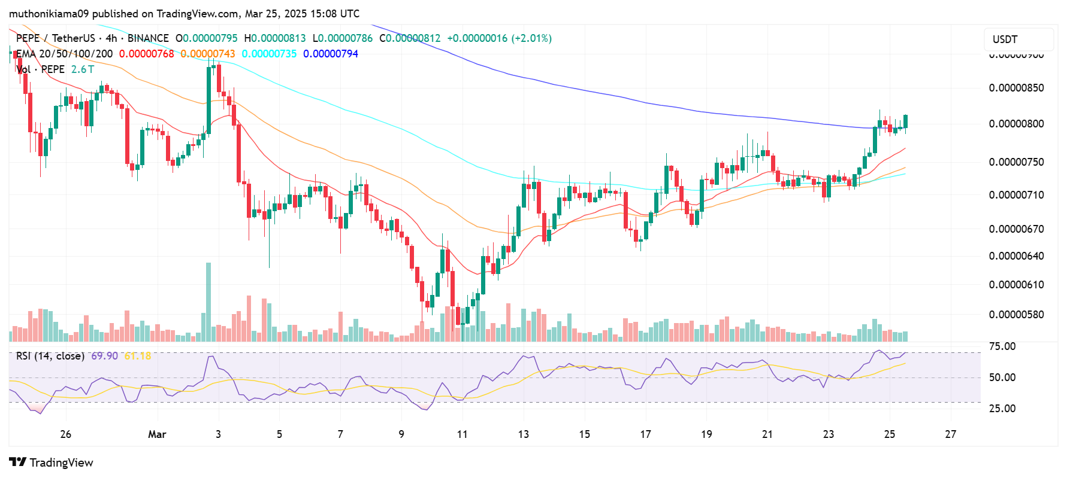
Examples where RNNs excel?
Time series prediction

Slide 8

Examples where RNNs excel?
2. Machine Translation

Slide 9

Examples where RNNs excel?
3. Text Generation

Slide 10

Examples where RNNs excel?
3. Text Prediction

Slide 11
Current Trends
Transformer Revolution
The introduction of Transformers marked a revolutionary shift in how machines process sequential data, such as text, time-series, or audio. Traditionally, tasks like machine translation, speech recognition, and language modeling relied heavily on Recurrent Neural Networks (RNNs) and their improved variants like LSTMs and GRUs. These models processed input sequentially — one step at a time — which made them inherently slow and difficult to parallelize during training. Moreover, RNNs struggled to capture long-range dependencies due to issues like vanishing gradients.
Transformers, introduced in the paper “Attention is All You Need” (Vaswani et al., 2017), eliminated recurrence entirely and instead used a mechanism called self-attention to process the entire sequence simultaneously. In this architecture, each token attends to every other token in the sequence with trainable attention weights, allowing the model to understand global relationships more efficiently. This design drastically improved both performance and training speed, especially on large datasets. As a result, Transformers quickly became the dominant architecture in NLP, forming the basis for powerful models like BERT, GPT, and T5. Today, Transformers outperform RNNs in almost every sequence modeling task — from translation and summarization to question answering and even music generation.
Transformer Revolution
Many sequence tasks now use attention-based models
Transformers often outperform RNNs
2. Hybrid Approaches
Combining RNNs with attention
Using RNNs as components in larger architectures
Hybrid Approaches
Although Transformers dominate many tasks, researchers also explored hybrid approaches that combine the best of both worlds: the sequential learning capabilities of RNNs and the flexibility and global awareness of attention mechanisms. One popular approach was to use an RNN (like an LSTM or GRU) to generate a sequence of hidden states, and then apply attention on top of those hidden states. This technique allows the model to selectively focus on important parts of the input when generating each output, improving translation quality, summarization coherence, and more. This is commonly known as attention over RNN outputs and was a key step in the evolution of sequence models, especially in machine translation before full Transformers took over.
Some hybrid models even integrate RNNs into Transformer-style architectures to exploit temporal dynamics or structured recurrence for certain domains like speech, video, or biomedical sequences. These combinations can help when working with small datasets, real-time constraints, or very long sequences where recurrence might still offer advantages. In essence, hybrid models allow flexibility in design, leveraging the contextual richness of RNNs with the scalability and precision of attention.

Slide 12
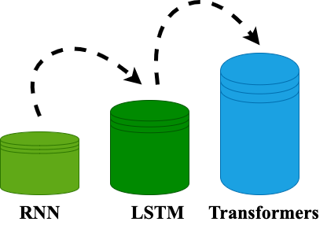
Roadmap

Slide 13
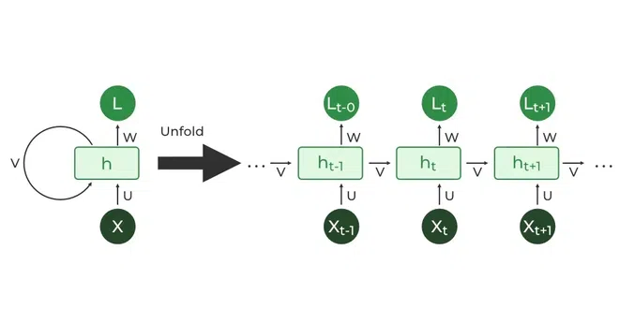
RNN Architecture

